Slide 1
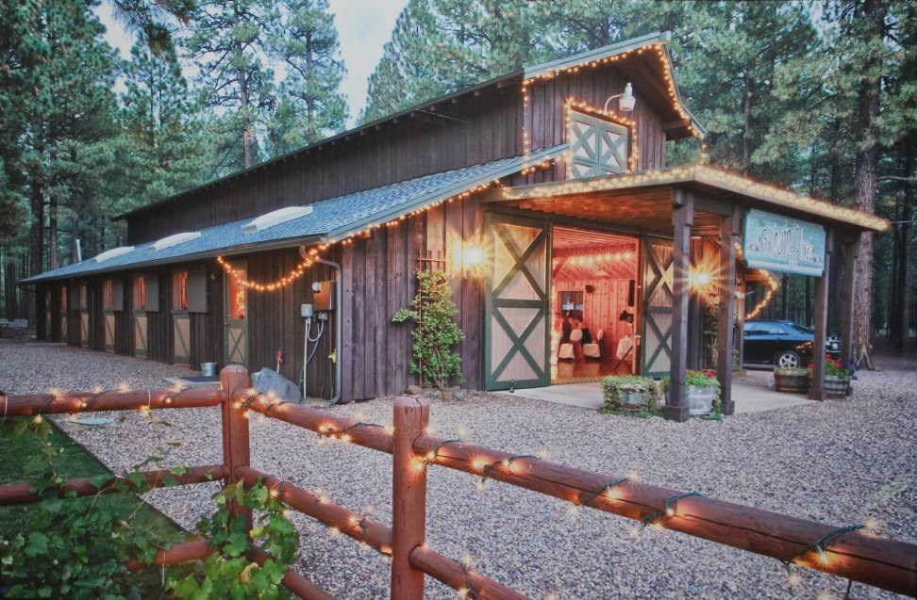
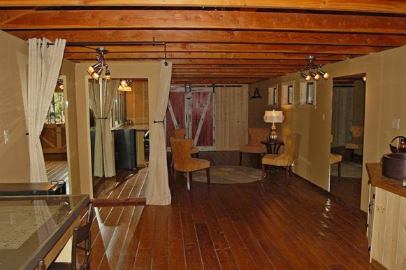
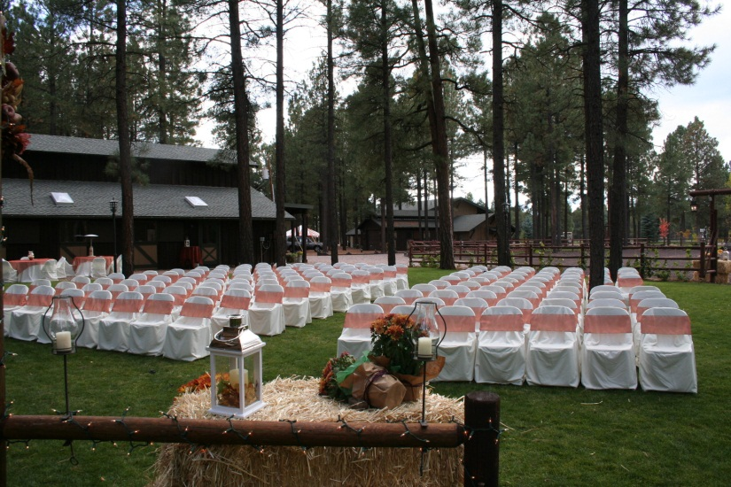
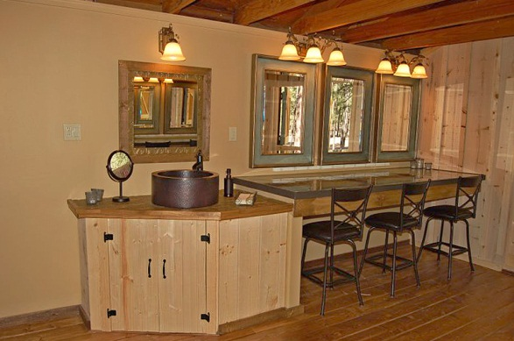
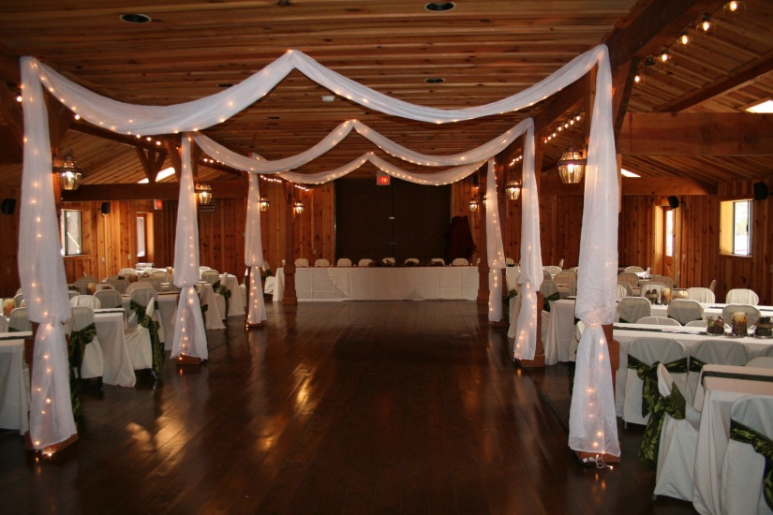
Ideal location for your
wedding, meeting, reunion, memorial
service, reception, company party, or
holiday get-together.
www.thegatheringplaceatpinetop.com
2020 Rates
Weddings & Receptions:
24 Hours $4,100.00
$1,370 due at signing
See page 2 for included amenities
Contact: Rachel
(928) 369-4000
rachel@resortaz.com

Slide 2
4756 Buck Springs Road, Pinetop, Arizona
www.thegatheringplaceatpinetop.com
Amenities:
Approximately 3000 square feet inside barn
Large outdoor ceremony area – accommodates 200
Rustic pine wedding arch outside that can be decorated
200 white wedding chairs for outside seating
Casual outdoor seating on open patio area
Ample parking on 2 acres,
Men’s and women’s restrooms
ADA compliant portable outdoor restroom April through October
Beautiful bride’s room with full length mirrors and 6 make-up stations
Kitchen with range, refrigerator and microwave oven
Many lighting options for just the right atmosphere
AV projector and screen
Laptop computer
Podium
Wifi
Indoor tables and banquet chairs for 200 guests
15-5ft round tables, 12-8ft rectangular tables
White floor length linens for indoor banquet tables
Round cake table; two beverage service tables
Three folding picnic tables, two wood picnic tables
24 hours guaranteed for weddings and receptions. Friday access for Saturday weddings for almost 48 hours at no extra charge
$400 of venue price returned to guest if all conditions of the contract are met.
Please contact Frank M. Smith & Associates, Inc.
for an appointment to preview this
facility and check availability.
(928) 369-4000

